Slide 1
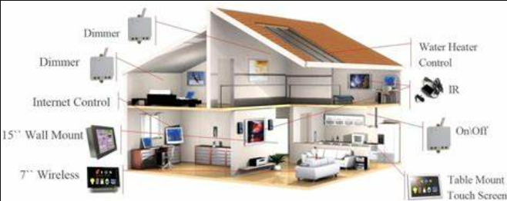
Home Automation using Alexa Skills Kit and Aws
By: 20IT075 Dhyani Panchal & 20IT088 Disha Patel
Guided by : Prof. Sandip Patel

Slide 2
Introduction
Home Automation is used to control systems and information technology to regulate equipment, industrial machinery, and processes, minimizing the need for human involvement. Automation plays an increasingly important role in the global economy.
A Smart Home is one that provides comfort and security. And this is possible using home automation system.

Slide 3
What is Home Automation?
Home automation is the automatic control of electronic devices in your home.
It gives you access to control devices in your home from a mobile device anywhere in the world.
Home automation makes life more convenient and can even save your money on heating, cooling and electricity bills. Home automation can also lead to a great safety with Internet of Things(IoT).
Understanding the term IoT:
The Internet of Things (IoT) refers to any device that is connected to the internet.
For example, a smart AC that you can turn on and off using an app. All home automation devices are IoT devices which can be automated to trigger one another. Home automation is what you can do with the IoT devices to make your life a bit easier.

Slide 4
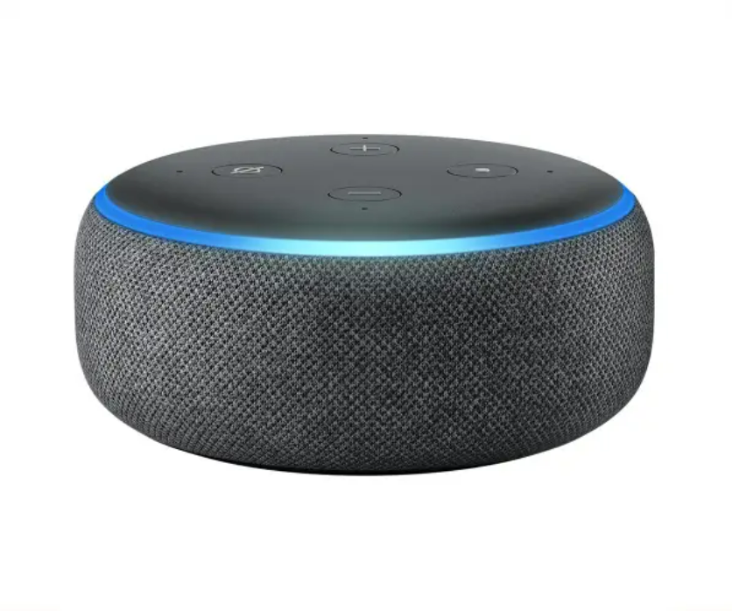
What is Alexa and its Working.
What is Alexa?
Alexa is Amazon's voice-based AI-powered digital assistant that powers an entire smart device ecosystem. Alexa can reply to simple queries and perform various tasks or commands that one gives.
Working of Alexa: -
User
Alexa
Amazon Alexa Services
Developer Application Services
Amazon Developer Portal

Slide 5
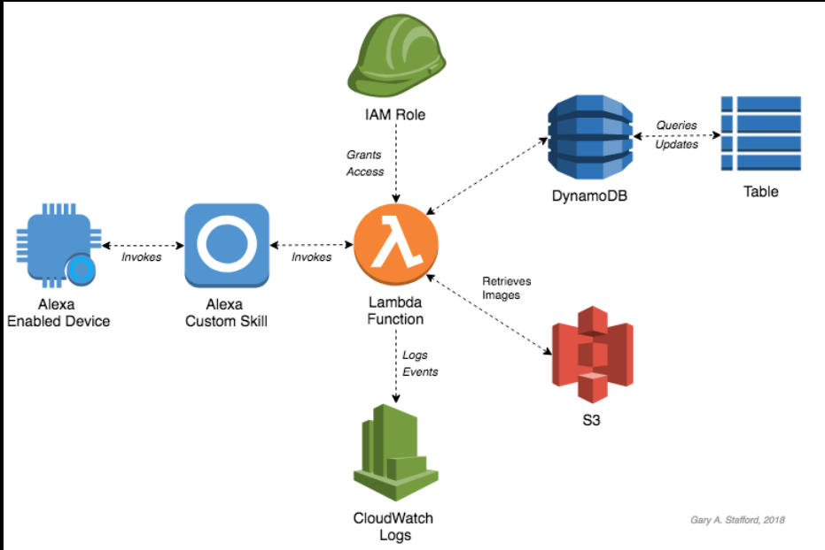
How does Home Automation works?
User
Alexa receives the message
Message decoded
Skill (Lambda Backend)
Skill Reacts

Slide 6
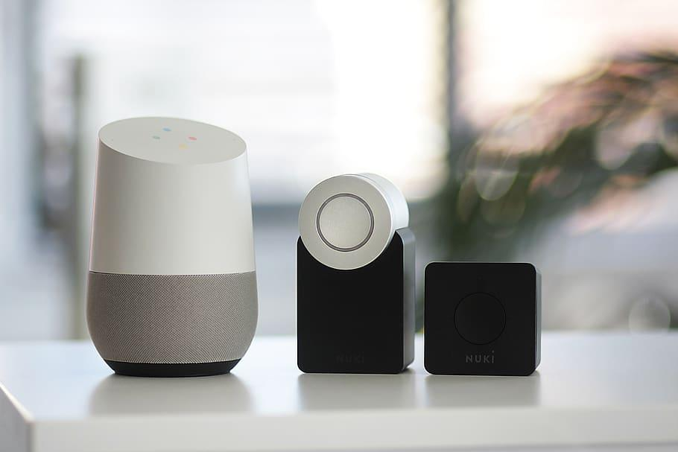
Home Automation System Components
• Alexa Echo (or a voice processing device.)
• IOT kit
• A relay to connect your IOT kit with your appliances.

Slide 7
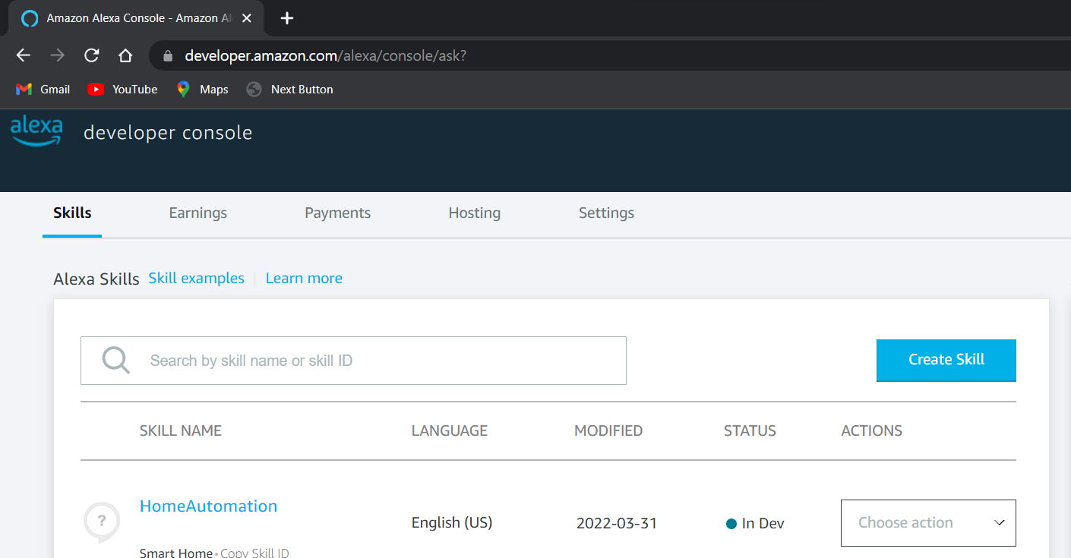
Steps to create a Skill
Firstly go to the amazon developer account and then go to skills and then click on create skill.

Slide 8
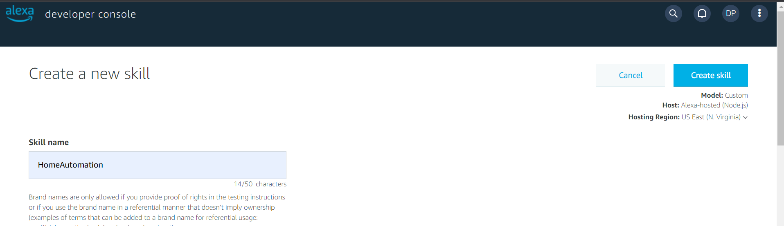
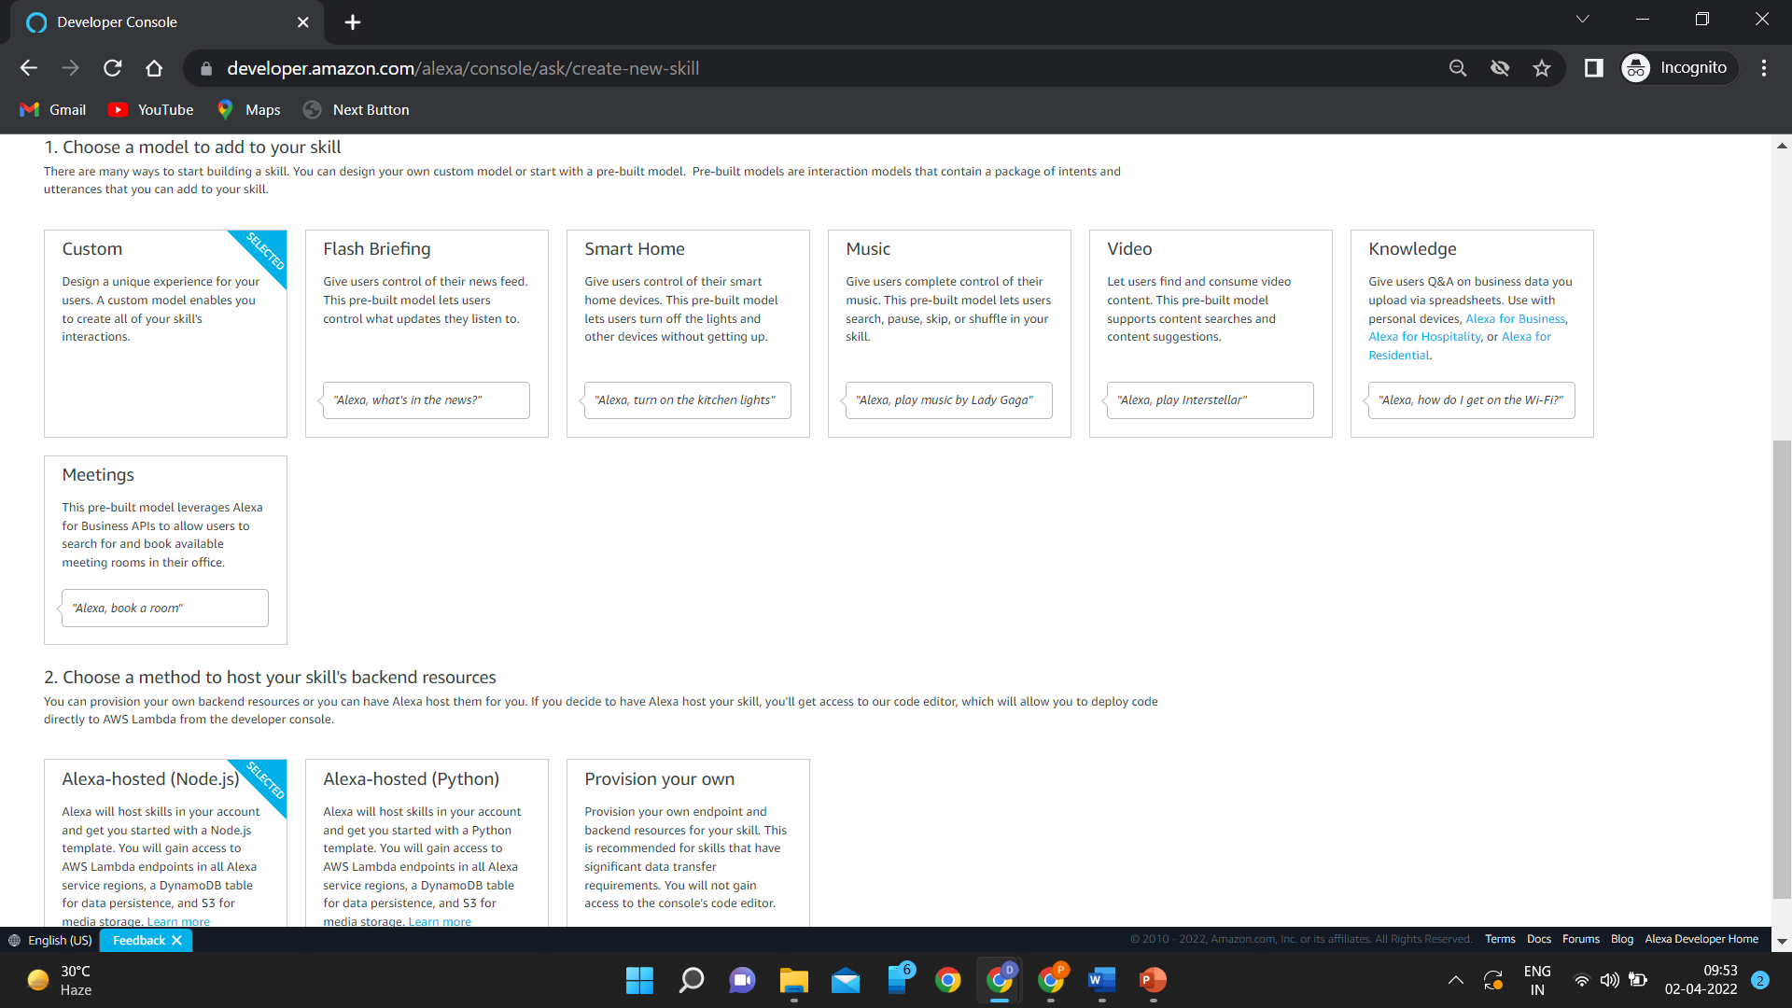
Give name to your skill.
In model choose the smart home.
And then select the Alexa – hosted Node.js or Python method to host your skill’s backend resource

Slide 9
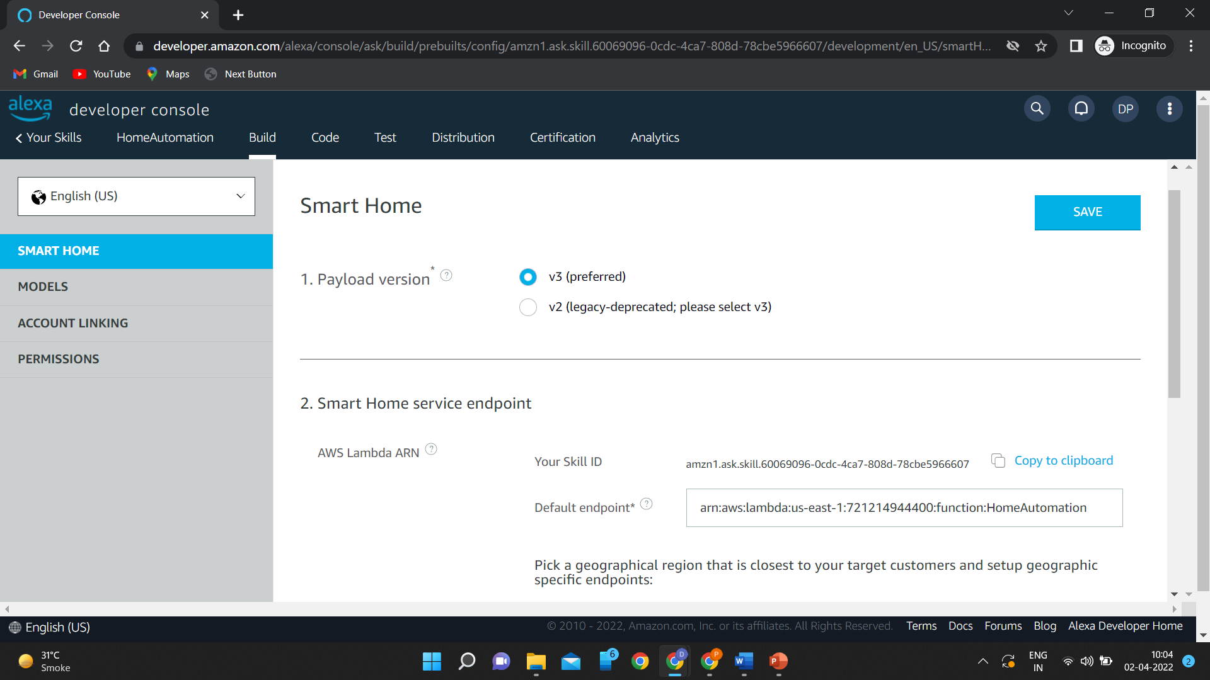
Select v3 in the payload version.
Copy your skill id and in the default endpoint copy the code of your lambda function created in your Aws account.

Slide 10
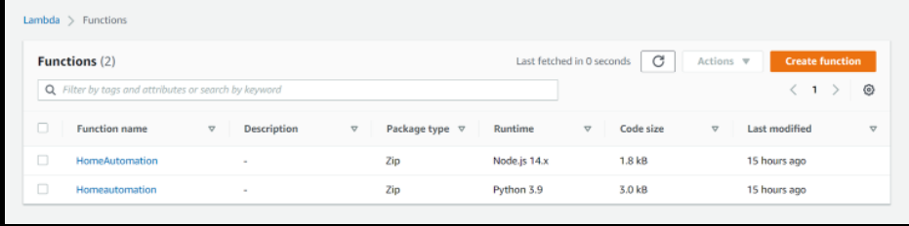
How to create Aws Lambda Function?
Go to your AWS account and in the search box find lambda. And then go to the Functions and click on Create Function.
Select the correct region for your function. For adding trigger select Alexa Smart Home. For Application ID paste your Skill ID.
And then implement the skill code.

Slide 11
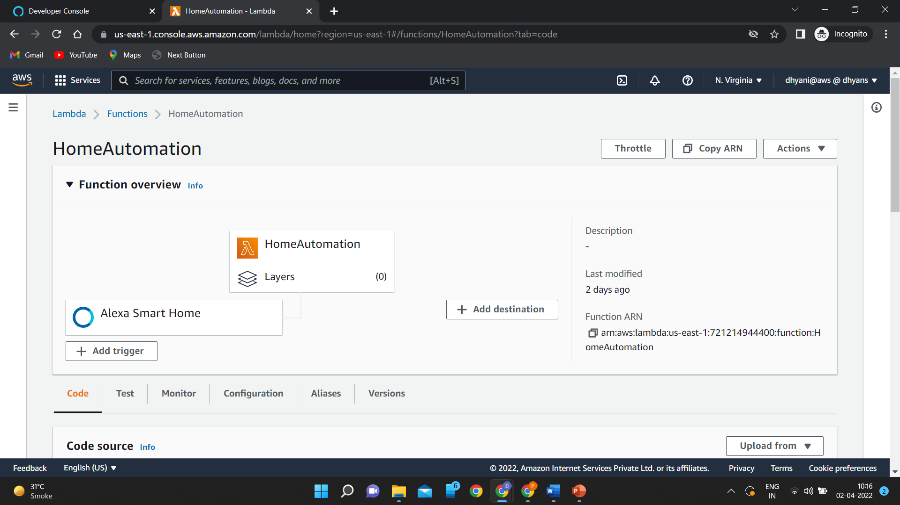
Copy the Function ARN to your skill.

Slide 12
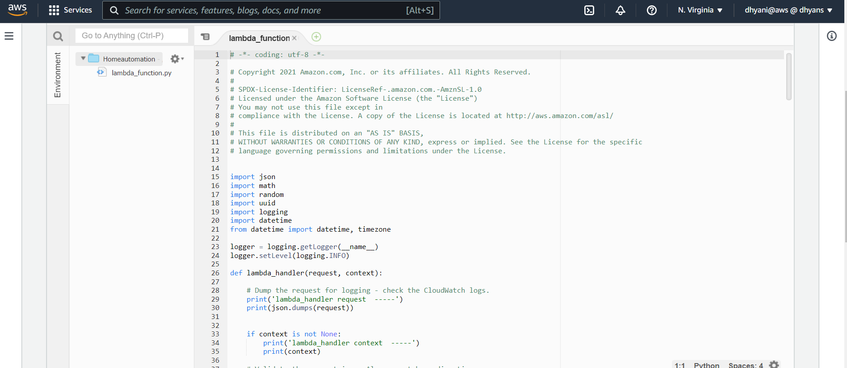
Aws Lambda Function

Slide 13
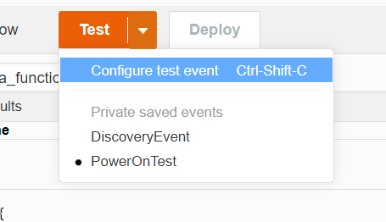
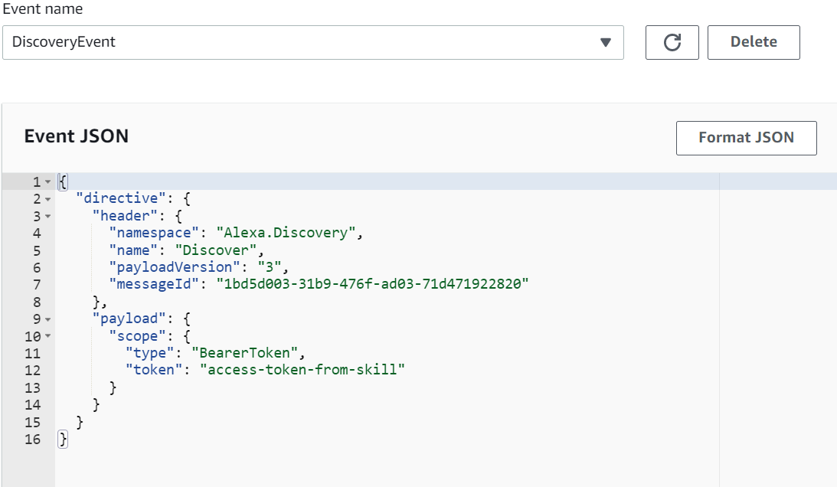
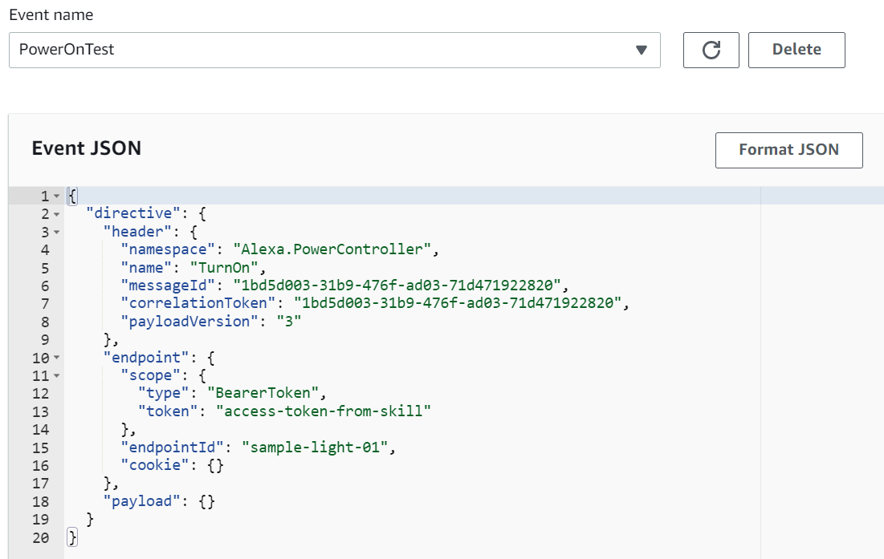
Codes For Testing : - (Events)

Slide 14
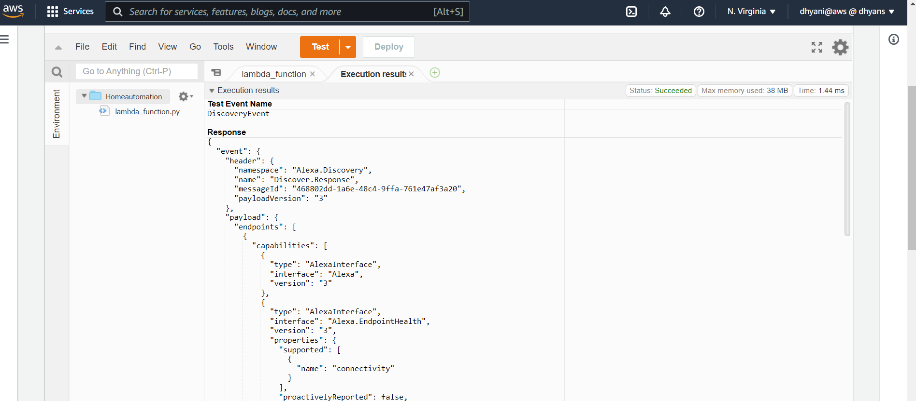
Output of the function(for Discovery Event)

Slide 15
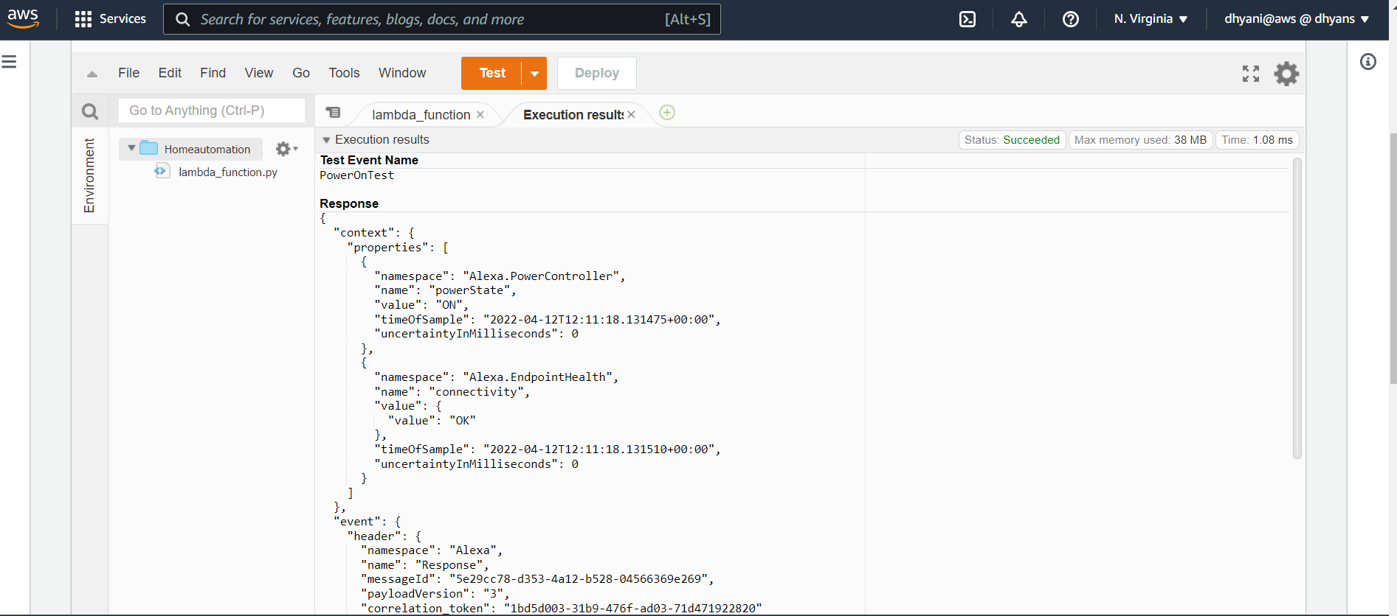
Output of the function(for Powerontest)

Slide 16
Last Step: Connect With Mobile
Download Alexa Application from play store in your mobile.
Sign in with the same credentials as in the amazon developer console.
Go in the Skills/Games section and then go to DEV.
Now link your skill with you device and YAY it’s done.

Slide 17
Conclusion
Main purpose of home automation system is to provide ease to people to control different home appliances with the help of the different remote control like Mobile Application, Voice Assistants, Alexa, etc. and to save electricity, time and money. This system also helps the user to protect their homes from burglars when they are away from the home by using alarm as the alarm will start ringing whenever a burglar tries to enter the house and the person will receive a message on his mobile phone whenever some other person will try to enter the owner’s house.

Slide 18
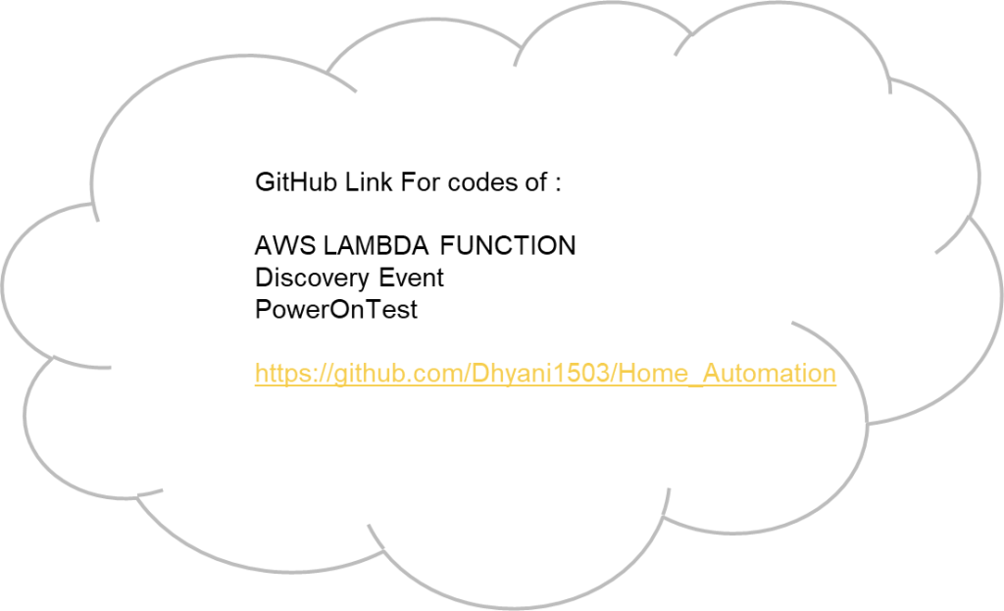
https://github.com/Dhyani1503/Home_Automation
Blog Link : https://homeautomation65924639.wordpress.com/blog-2/

Slide 19
Thank You

